Slide 1
Spring Boot - Mapping /error path to a custom controller by implementing ErrorController
By default Spring Boot maps /error to BasicErrorController which populates model with error attributes and then returns 'error' as the view name to map application defined error pages.
To replace BasicErrorController with our own custom controller which can map to '/error', we need to implement ErrorController interface.

Slide 2
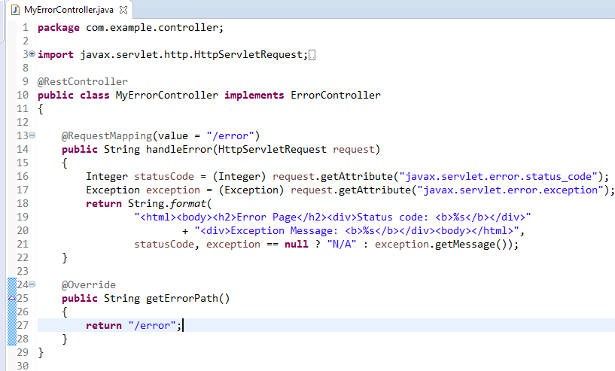
Spring Boot - Mapping /error path to a custom controller by implementing ErrorController
We have to create a class that implements the ErrorController interface and overrides its getErrorPath() to return a custom path to call when an error occurred:

